Slide 1
Effects of Smoking on Lung Adenocarcinoma Gene Expression
Jess White
ANGSD 2020
April 17, 2020

Slide 2


Summary of career development activities
Informational Interview
Networking Event
[TO COME]
Attended WCM Alumni Fireside Chat on April 7, 2020
Panelists have backgrounds in biotech, consulting, finance, policy, medical writing, and academia

Slide 4
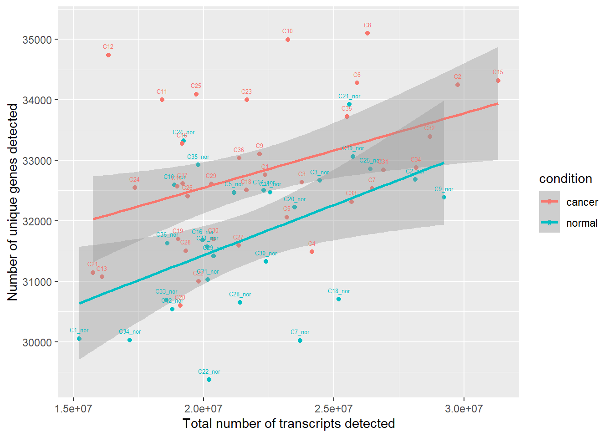
Despite a lower

Slide 5
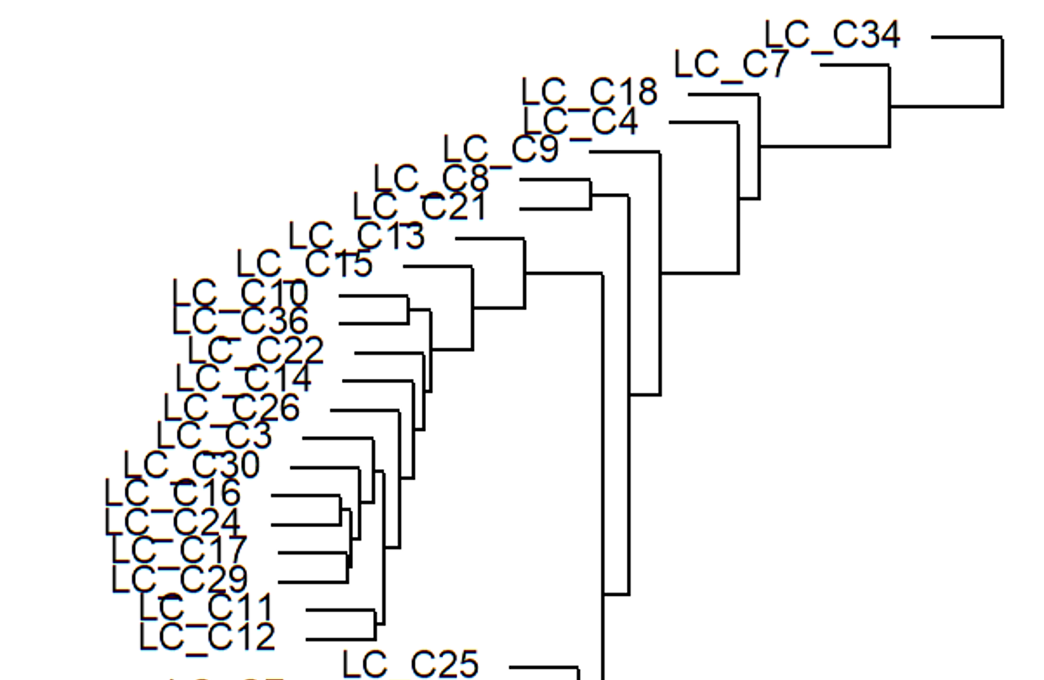
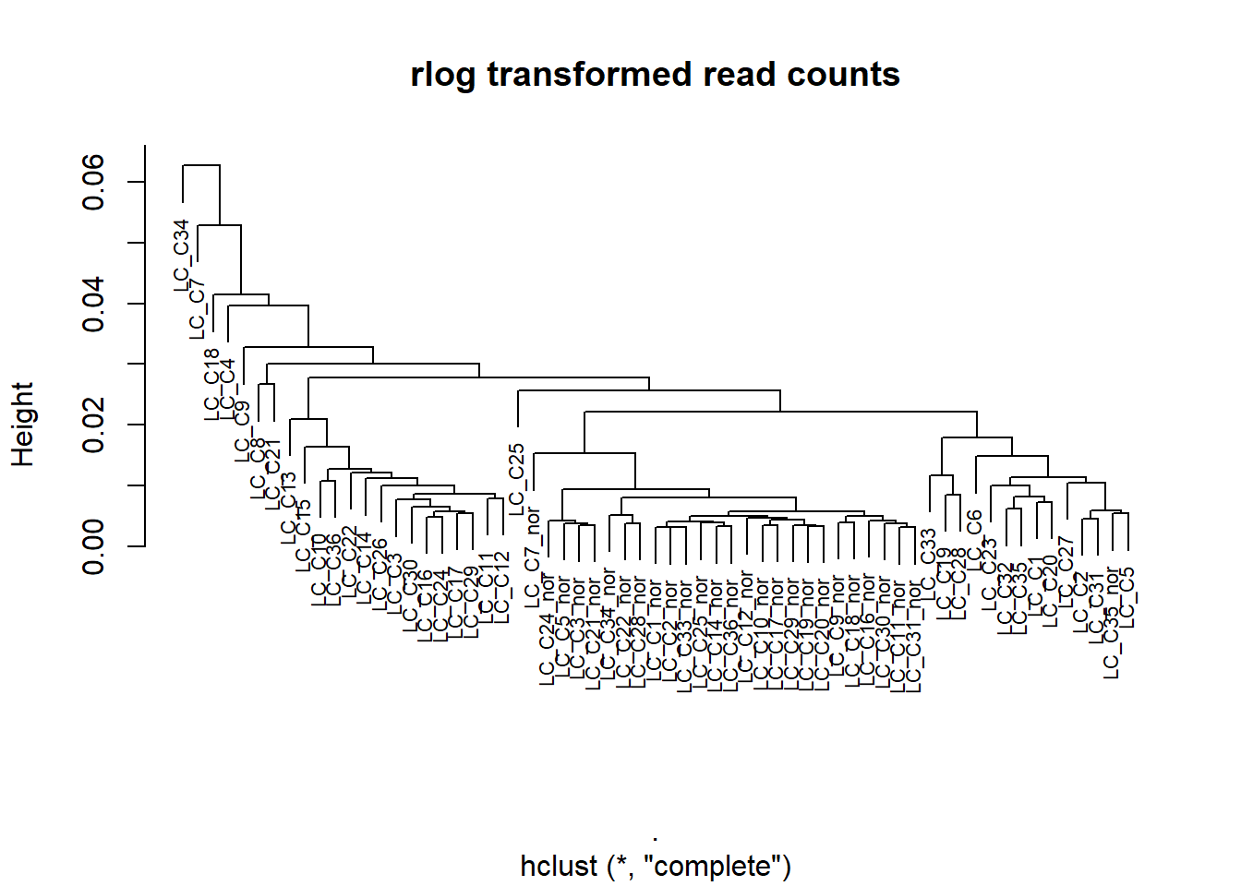

Slide 6
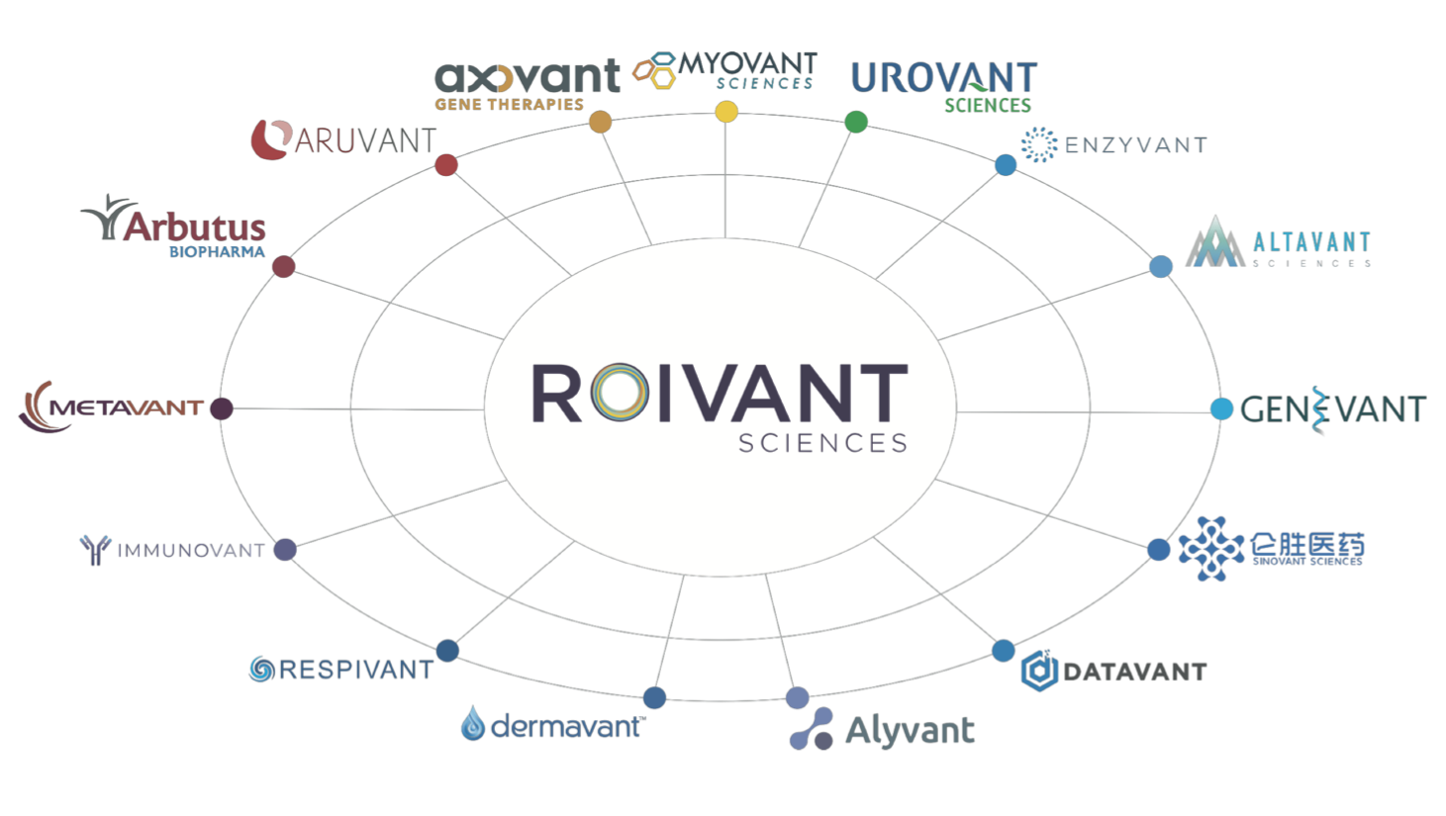
New team bridges operations and investments
Informational interview with Jonathan Jones (Head of Talent, Roivant Pharma)
Roivant has developed a “hub and spoke” model of drug development
Business development teams at the Vants and investment team are currently separated
Roivant is developing a new internal team to bridge the
Given that there are no current members on the team, I spoke with the recruiter and wasn’t able to
Business development team and investment team
• Clinical team
• Structure of Vants decentralized, autonomous
○ Given majority or sizeable ownership, have governance team
• Cash burn, capital requirements, roll-up financials
○ Work in partnership with executive teams - support, advise, and to some extent supervise
○ Can range from clinical trial design, bringing in new assets, budgeting new assets
○ Frank Torti (Investment Chair), Operating Partner - Myrtle Potter will be CBO of NewCo,
○ Eric Venker (Roivant COO)
• Proprietary tech, familiar and have worked with the Precision Medicine Institute at Weill Cornell

Slide 7
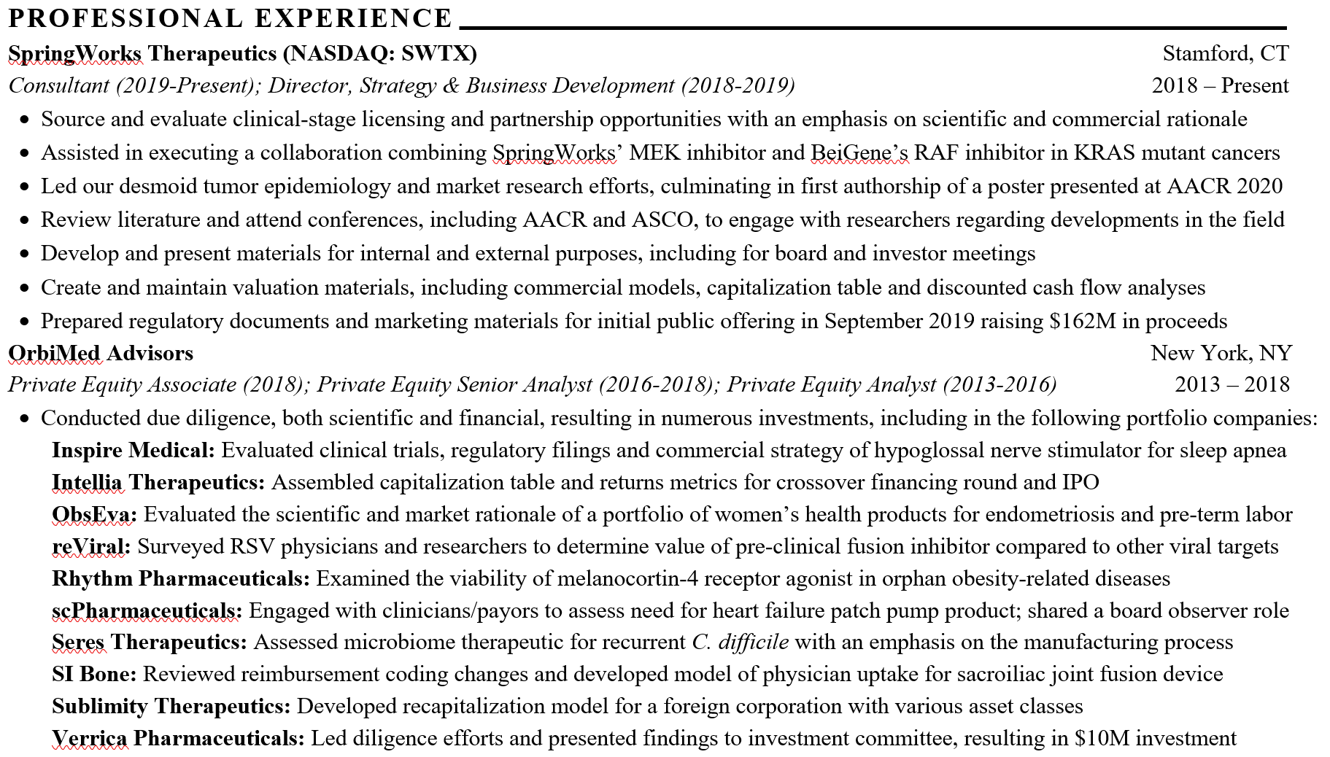
My background is highly compatible with the team
Additionally, Roivant has a te

Slide 8
WCM Alumni Fireside Chat
The Tri-Institutional Biotech Club & Startup Venture Club
Dane Samilo (Policy) - AAAS Science and Technology Policy Fellow at DoD. IMP ‘18
Ritama Gupta (Medical Writing/Pharma) - Medical Writer at ICON plc. IMP ‘17
Bill Mills (Hedge Fund/Investing) - Analyst at Camber Capital Management. Pharm ‘15/MBA ‘16
Alisa Dong (Startups/Consulting) - Director of Strategy & Operations at Aruvant (gene therapy). BCMB‘16
Faranak Fattahi (Academia) – Sandler Faculty Fellow Department of Biochemistry and Biophysics at UCSF. WCM ‘16

